Slide 1

Data Visualization Techniques & Best Practices
TOPS TECHNOLOGIES
Submitted by:- Ruchit Thummar

Slide 2
OUTLINE
Introduction
Common Visualization Techniques
Chart Selection: Telling the Right Story
Best Practices in Visualization Design
Best Practices in Interpretation
Tools for Visualization
Conclusion

Slide 3
Introduction
What is Data Visualization?
The process of converting raw data into visual formats such as charts, graphs, and dashboards.
A method to communicate information clearly and effectively using graphics.
It helps audiences see the story behind the numbers rather than just reading tables or reports.
Why it Matters?
Data visualization simplifies complexity by making large or complicated datasets easier to understand.
It reveals patterns and trends, helping us quickly identify relationships, correlations, and outliers.
Clear visuals support decision-making by allowing managers and stakeholders to act with confidence and speed.
Well-designed visuals engage the audience, capturing attention and making insights more memorable.

Slide 4
Common Visualization Techniques
Bar Charts - Bar charts are one of the simplest and most widely used visuals. They allow us to easily compare values across different categories side by side.
Ex: Comparing sales performance across regions such as North, South, East, and West.
Line Charts - Line charts are perfect for showing changes over time. They help us quickly see whether performance is rising, falling, or staying steady.
Ex: Tracking monthly revenue growth over the past year.
Pie/Donut Charts - These charts are useful when we want to show proportions and see how different parts contribute to a whole.
Ex: Displaying the market share held by different companies in the same industry.

Slide 5
Scatter Plots - Scatter plots are best for showing relationships or correlations between two variables. They can reveal patterns that are not obvious in tables.
Ex: Exploring whether higher advertising spend leads to higher sales revenue.
Heatmaps - Heatmaps use colors to represent values, making it easy to see intensity and patterns at a glance. They are excellent for highlighting areas of high or low activity.
Ex: Visualizing which parts of a website get the most clicks.
Dashboards - Dashboards bring different visualizations together in one place, providing a complete picture. They are especially useful for monitoring performance in real time.
Ex: A business dashboard showing sales, profits, and customer engagement all at once.

Slide 6
Chart Selection: Telling the Right Story
Not every chart fits every situation. Choosing the right chart type depends on the story you want to tell and the type of data you have.
Trends over Time → Line Chart, If you want to show how something changes over days, months, or years, a line chart is the clearest choice.
Ex: Visualizing revenue growth month by month.
Comparisons → Bar Chart, When comparing categories side by side, bar charts are the easiest to read.
Ex: Comparing product sales across different regions.
Proportions → Pie or Donut Chart, To show how parts make up a whole, pie or donut charts work well, but they should be kept simple.
Ex: Showing the percentage of market share for each company.

Slide 7
Distribution → Histogram or Box Plot,When you need to show how data is spread or whether there are outliers, these charts are more suitable.
Ex: Displaying the distribution of customer ages.
Relationships → Scatter Plot,To explore how two variables are related, scatter plots help uncover correlations.
Ex: Analyzing the relationship between advertising budget and sales.

Slide 8
Best Practices in Visualization Design
Design plays a crucial role in how effectively your audience understands the data. A well-designed chart communicates insights quickly, while a poor design creates confusion.
Use Consistent and Limited Colors Stick to 3–5 colors and apply them consistently across charts. Use bold or contrasting colors only to highlight important insights.
Ensure Clear Labels and Titles Every chart should be self-explanatory. Use meaningful titles, axis labels, and legends when necessary.
Maintain Visual Balance Ensure that charts are not overcrowded, text is readable, and spacing is even. A clean layout improves comprehension.
Keep It Simple Avoid clutter and unnecessary elements. Simplicity ensures the audience focuses on the key message.

Slide 9
Best Practices in Interpretation
Interpretation simply means explaining the meaning of something so others can understand it.
Designing a chart is only the first step interpreting it correctly is just as important. Misinterpretation can lead to wrong conclusions and poor decisions.
Avoid Misleading Scales, Do not manipulate axes or scales in a way that distorts the data. Always start from zero when appropriate to maintain accuracy.
Keep Legends Only When Needed Avoid unnecessary legends if labels can be placed directly on the chart. This reduces cognitive effort for the reader.
Encourage Critical Thinking Remind the audience that charts tell a story, but interpretation requires careful thought and questioning.

Slide 10
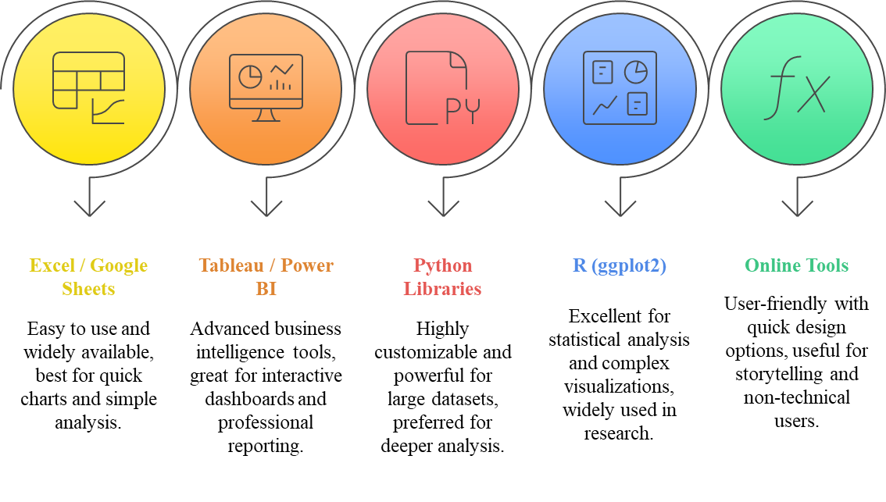
Tools for Visualization

Slide 11
Conclusion
Data visualization is more than just creating charts, it is a way of turning complex information into meaningful stories.
Selecting the right visualization technique helps highlight trends, comparisons, proportions, distributions, and relationships in data.
Strong design practices clarity, simplicity, balance, and consistent use of color make insights easy to grasp and reduce confusion.
Interpretation is just as important as design; it ensures visuals are understood correctly, avoids misleading conclusions, and encourages critical thinking.
Effective visualization combined with thoughtful interpretation empowers decision-makers, improves communication, and builds confidence in data-driven choices.

Slide 12
THANK YOU

